Slide 1

CONCRETE PROJECTS (TRANSPORTATION PROBLEM)
Justice Inkoom

Slide 2
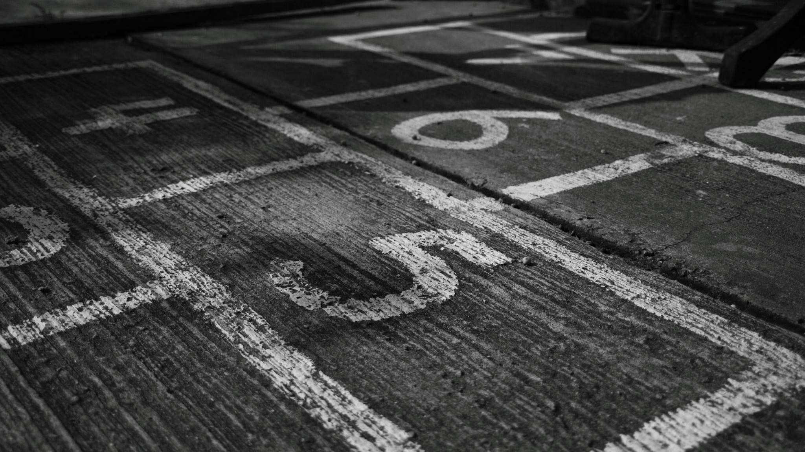
SCENARIO
The Osbourne Concrete Company has plants in three locations and is currently working on three major construction projects, each located at a different site. The shipping cost per truckload of concrete, daily plant capacities, and daily project requirements are provided in the table below.
Determine the least-cost way for Osbourne Concrete to meet their requirements.
 | Project A | Project B | Project C | Capacity
Plant 1 | 10 | 4 | 9 | 80
Plant 2 | 12 | 6 | 8 | 40
Plant 3 | 8 | 9 | 5 | 30
Requirements | 50 | 40 | 60

Slide 3
T. TEMPLATE
 |  | Projects
 | Data table: | Project A | Project B | Project C | Capacity
locations | Plant 1 | 10 | 4 | 9 | 80
 | Plant 2 | 12 | 6 | 8 | 40
 | Plant 3 | 8 | 9 | 5 | 30
 | Requirements | 50 | 40 | 60
 |  | Projects
 | Shipment table: | Project A | Project B | Project C | Capacity
locations | Plant 1 | 40 | 40 | 0 | 80
 | Plant 2 | 0 | 0 | 40 | 40
 | Plant 3 | 10 | 0 | 20 | 30
 | Requirements | 50 | 40 | 60
Total Shipment cost (Min): $1,060

Slide 4
QUESTIONS
How many truckloads of concrete should Plant 1 ship to each project?
Answer: 40 truckloads to Project A, 40 truckloads to Project B, and no shipment to Project C.
2. How many truckloads of concrete should Plant 2 ship to each project?
Answer: No shipment to Project A, no shipment to Project B, and 40 truckloads to Project C.
3. How many truckloads of concrete should Plant 3 ship to each project?
Answer: 10 truckloads to Project A, no shipment to Project B, and 20 truckloads to Project C.
4. What is the total minimal shipping cost?
Answer: $1060

Slide 5
SUMMARY
This project was set up with one of the transportation problem templates. The Solver Add-in was used to show that the minimal shipping cost for the concrete is $1060. This minimum cost was achieved with the following plan:
1. Send 40 truckloads of concrete from Plant 1 to Project A and send 40 truckloads from Plant 1 to Project B. Nothing goes from Plant 1 to Project C.
2. Send 40 truckloads of concrete from Plant 2 to Project C. Nothing goes from Plant 2 to either of the other projects.
3. Send 10 truckloads of concrete from Plant 3 to Project A and send 20 truckloads from Plant 3 to Project C. Nothing goes from Plant 3 to Project B.

Slide 6
THANK YOU

